Slide 1
An overview of UML
Eduardo B. Fernandez
Florida Atlantic University
Boca Raton, FL
http://www.cse.fau.edu/~ed
1

Slide 2
Outline
Background
Model management
Classes and associations
Use cases
Object interaction

Slide 3
Outline (Cont.)
State diagrams
Activity diagrams
Implementation diagrams
Process aspects
Summary

Slide 4
What is UML
UML (Unified Modeling Language) is an object-oriented language for specifying, constructing, visualizing, and documenting a software design.
Basically a notation and its corresponding meaning, not a process.
Developed at Rational by J. Rumbaugh, G. Booch, and I. Jacobson.

Slide 5
Status
A specification defining a graphical language for visualizing, specifying, constructing, and documenting the artifacts of distributed object systems.
Publication Date:
  May 2015
A specification defining a graphical language for visualizing, specifying, constructing, and documenting the artifacts of distributed object systems.
Publication Date:
  May 2015
Version 1.1, September 1997
In 1997 UML was adopted as a standard by the Object Management Group (OMG)
In 2005 UML was adopted by the International Organization for Standardization (ISO) as an approved ISO standard.
UML 2.5 was released in October 2012 as an "In process" version and was officially released in 2015.
Contributors : Rational, IBM, HP, MCI, TI, Microsoft, Oracle, I-Logix, ObjecTime,...
Adopted by many companies

Slide 6
UML 2.x
There are four parts to the UML 2.x specification:
The Superstructure that defines the notation and semantics for diagrams and their model elements
The Infrastructure that defines the core metamodel on which the Superstructure is based
The Object Constraint Language (OCL) for defining rules for model elements
The UML Diagram Interchange that defines how UML 2 diagram layouts are exchanged

Slide 7
What is O-O design?
Design based on data together with their operations, not on data transformations
Objects model the aspects of the real world which are of interest in some context
Can be used for designing applications, system programs, hardware, database modeling, web-based systems, XML modeling; that is, almost every kind of software

Slide 8
UML tools
Purposes:
Diagram drawing-- creating and editing UML diagrams, some support also BPMN and SysML
Code generation. The UML tool derives from the diagrams part or all of the source code.
Reverse engineering. The UML tool reads program source code as input and derives model data and corresponding graphical UML diagrams from it
Round-trip engineering--the ability of a UML tool to perform code generation from models, and model generation from code (a.k.a., reverse engineering), while keeping both the model and the code semantically consistent with each other.

Slide 9
More features
Model and Diagram Interchange. XML Metadata Interchange (XMI) is the format for UML model interchange between systems.
Model Transformation. A concept associated with Model-Driven Architecture, is the capacity to transform a model into another model. For example, one might want to transform a platform-independent domain model into a Java platform-specific model for implementation. It is also possible to refactor UML models to produce more concise and well-formed UML models. It is possible to generate UML models from other modeling notations, such as BPMN. The standard that supports this is called QVT for Queries/Views/Transformations. One example of an open-source QVT-solution is the ATL language built by INRIA.

Slide 10
Free UML tools
http://en.wikipedia.org/wiki/List_of_UML_tools
ArgoUML is an open source UML modeling tool and includes support for all standard UML 1.4 diagrams. It runs on any Java platform and is available in ten languages. http://argouml.tigris.org/
Available in your cloud desktops
BOUML is a free UML 2 tool box including a modeler to specify and generate
code in C++, Java, Idl, Php, Python and MySQL.
http://www.bouml.fr/

Slide 11
Eclipse and Papyrus
Open source products available in your cloud desktops
Eclipse is a development tool with many plug-ins (an ecosystem)
http://help.eclipse.org/neon/index.jsp?nav=%2F0
Eclipse is an open source community which develops open platforms and products. The community says "[its] projects are focused on building an open development platform consisting of extensible frameworks, tools and runtimes for building, deploying and managing software across the lifecycle“. The Eclipse Foundation is a non-profit corporation which acts as the steward of the Eclipse community.
Papyrus is an open source modeling tool that is part of the Eclipse Ecosystem.
Implemented standards: UML 2.5.0, SysML 1.1 & 1.4, OCL 2.3.1, fUML 1.1, ALF 1.0.1, MARTE 1.1, EAST-ADL, RobotML , UML-RT and ISO/IEC 42010.
https://eclipse.org/papyrus/

Slide 12
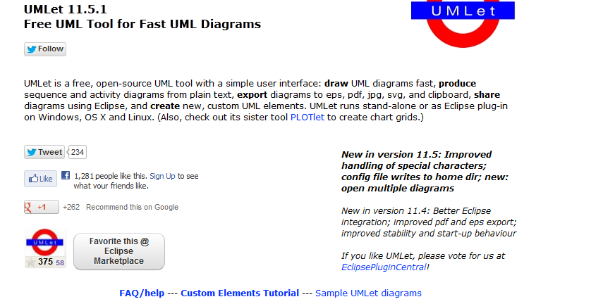
http://www.umlet.com

Slide 13
More UML tools (paid)
Lucidchart
https://www.lucidchart.com/pages/landing/uml_diagram_tool?utm_source=modeling_languages&utm_medium=cpc&utm_campaign=uml_diagram_tool
Software Ideas Modeler
https://www.softwareideas.net/
smart diagram software with UML, SysML, ERD, BPMN, ArchiMate,
flowcharts, user stories, wireframe support

Slide 14
Gliffy https://www.gliffy.com/uses/uml-software/
Creating a flowchart, uml diagram, org chart, or any other kind of diagram using the Gliffy diagram tool is the first step to turning your idea into a reality.
It is also a great way to get clarity and figure out next steps. Whether you’re an engineer creating a revolutionary piece of software, a manager clarifying roles and responsibilities, or just a person trying to figure out the complex relationship between ninjas, pirates and zombies, Gliffy diagram software has all the tools you need to get started.

Slide 15
Good UML textbooks (there are several poor ones)
S. Ambler, “The elements of UML 2.0 style”
UML @ Classroom: An Introduction to Object-Oriented Modeling (Undergraduate Topics in Computer Science) 2015 Edition , Springer International by Martina Seidl, Marion Scholz, Christian Huemer, Gerti Kappel
C. Larman, Applying UML and Patterns: An Introduction to Object-Oriented Analysis and Design and Iterative Development (3rd Ed.), Prentice Hall, 2004
Object-Oriented Software Engineering:
Practical Software Development using UML and Java (2nd Ed.), Timothy C. Lethbridge and Robert Laganière
McGraw Hill, 2001

Slide 16
Value of precise modeling
Fundamental to build complex systems. These cannot be understood or built correctly without a conceptual model
Semiformal approach -- intuitive
Useful for development and documentation
Notation is not useful unless you already know OOA/OOD concepts

Slide 17
Diagrams
Requirements--Use case
Data model (static)--Class
Behavior (dynamic) -- state, activity, sequence, collaboration
Implementation -- component, deployment
Different views of a system

Slide 18
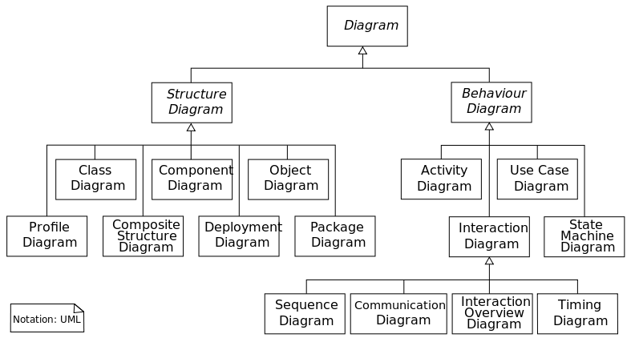
14 diagrams

Slide 19
OOA lifecycle
Requirements : Use cases
Analysis : class diagrams, state diagrams, sequence diagrams
Design : refined class diagrams, collaboration diagrams, operation descriptions, class contracts, patterns
Implementation : component and deployment diagrams

Slide 20
Packages
A grouping of model elements for model management and organization
Packages own elements
Elements are other packages or classes
Basis for configuration control, storage, and access control
Useful to delimit work scope

Slide 21
Example of a package
<<subsystem>>
Editor
Controller
Data
Elements
Domain
Elements
Graphics
Core
Windowing
System
MotifCore
Motif
Windows
Core
Microsoft
Windows

Slide 22
Manufacturing system
Customer_Orders
Shop_
Orders
Manu-facturing
Inventory
Components
Shipping

Slide 23
Stereotypes
A stereotype is a new class of modeling element introduced at modeling time
A subclass of an existing model element with the same form but different intent
Built-in extensibility mechanism for UML

Slide 24
Example of stereotypes
<<control>>
PenTracker
<<control>>
PenTracker
location: Point
location: Point
enable (Mode)
enable (Mode)
PenTracker
location: Point
enable (Mode)

Slide 25
Static model
Classes
Associations between classes
Objects
Operations
Attributes
Parameter types

Slide 26
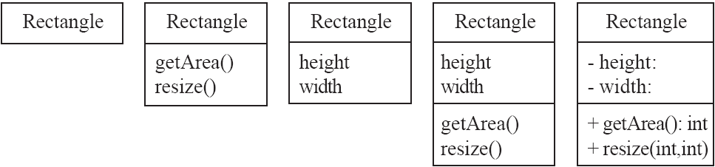
Classes
A class is simply represented as a box with the name of the class inside
  The diagram may also show the attributes and operations
  The complete signature of an operation is:
    operationName(parameterName: parameterType …): returnType

Slide 27
Class notation
Window
Window
{abstract,
author=Joe,
status=tested}
+size:Area = (100,100)
#visibility: Boolean = invisible
+default-size: Rectangle
#maximum-size:Rectangle
-xptr: XWindow*
Window
size: Area
visibility:Boolean
+display()
+hide()
+create()
-attachXWindow(xwin:Xwindow*)
display()
hide()

Slide 28
Classes and objects
p1:Point
Point
x=3.14
y=2.718
x:Real
y:Real
rotate(angle:Real)
scale(factor:Real)
:Point
x=1
y=1.414

Slide 29
Generalization
Customer
name
address
creditRating():String
CorporateCustomer
PersonalCustomer
contactName
creditRating
creditLimit
creditCard#
remind()
billForMonth(Integer)
{creditRating() == “poor”}

Slide 30
Associations
Collaboration of two (or more) classes to define a meaningful fact
Associations have multiplicities (one to one, one to many, many to many), and direction
Analysis associations are usually bidirectional

Slide 31
Association example
Order
Customer
dateReceived
isPrepaid
number : String
price:Money
*
1
name
address
dispatch()
close()
Navigability
creditRating():String

Slide 32
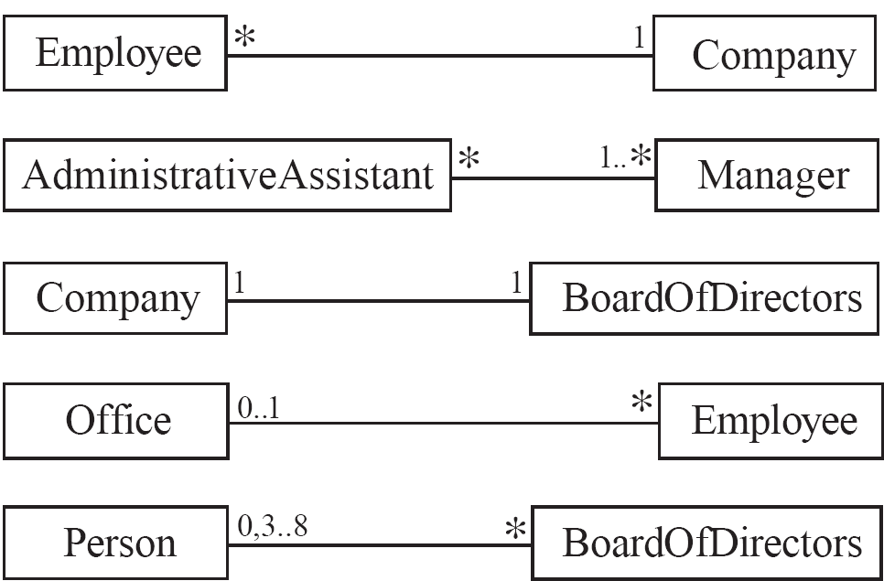
5.3 Associations and Multiplicity
An association is used to show how two classes are related to each other
  Symbols indicating multiplicity are shown at each end of the association

Slide 33
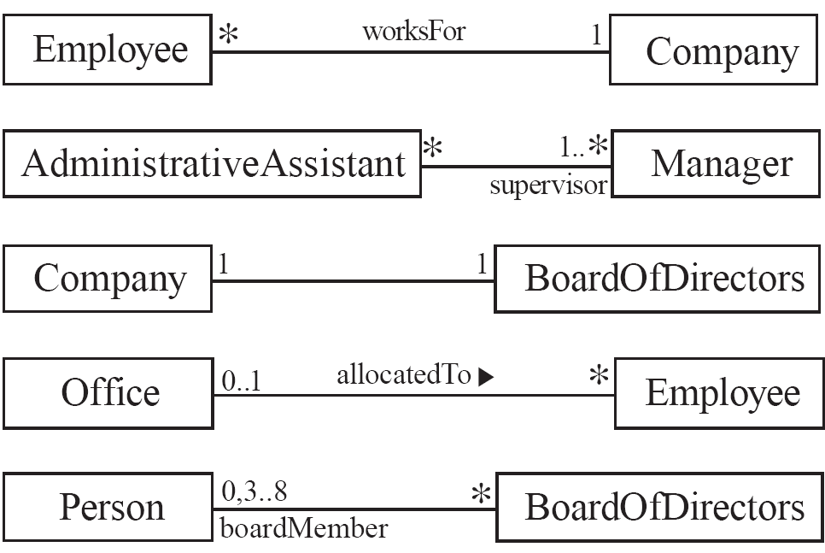
Labelling associations
  Each association can be labelled, to make explicit the nature of the association

Slide 34
Constraints
*
Member-of
*
Person
{subset}
Committee
Represents
an incorporated entity
1
Chair-of
*
worker
employee
employer
*
Person
*
0..1
Company
0..1
boss
{Person.employer =
Person.boss.employer}

Slide 35
Association class
*
Job
1..*
Company
Person
employer
employee
Job
salary
boss
0..1
worker
*
Manages

Slide 36
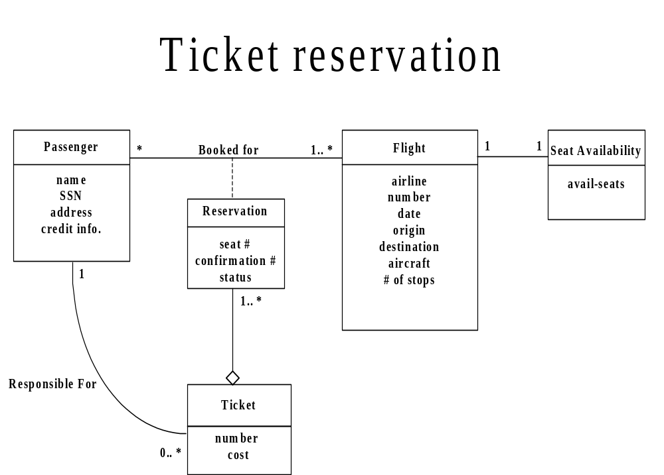

Slide 37
Composition/aggregation
Window
scrollbar [2]:Slider
title: Header
body: Panel
Window
1
1
1
scrollbar
2
title
1
body
1
Slider
Header
Panel

Slide 38
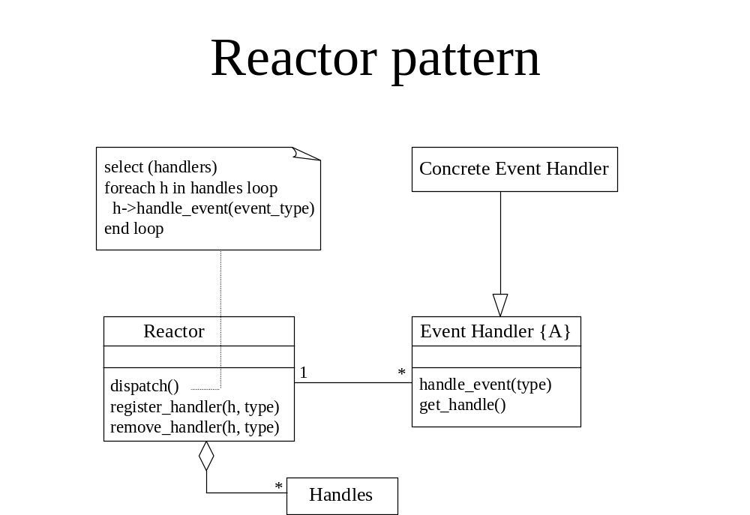

Slide 39
Orders model
Order
dateReceived
isPrepaid
number : String
price : Money
Customer
*
1
name
address
creditRating():String
dispatch()
close()
Navigability
1
Corporate
Customer
Personal
Customer
{if Order.customer.creditRating is
“poor” then Order.isPrepaid
must be true}
creditCard#
contactName
creditRating
creditLimit
{creditRating() == “poor”}
remind
billForMonth(Integer)
*
OrderLine
*
quantity : Integer
price : Money
isSatisfied:Boolean
sales rep
0..1
*
1
Product
Employee

Slide 40
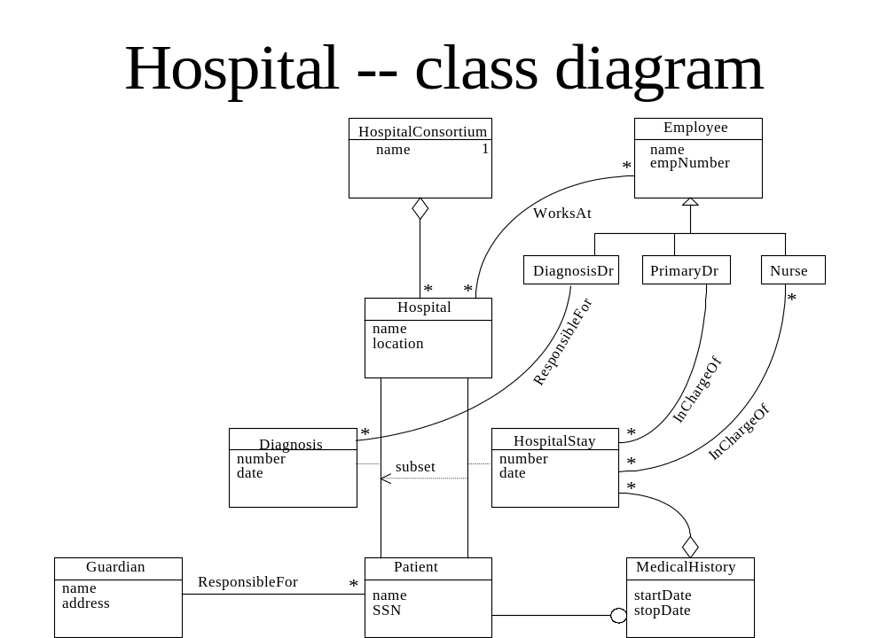

Slide 41
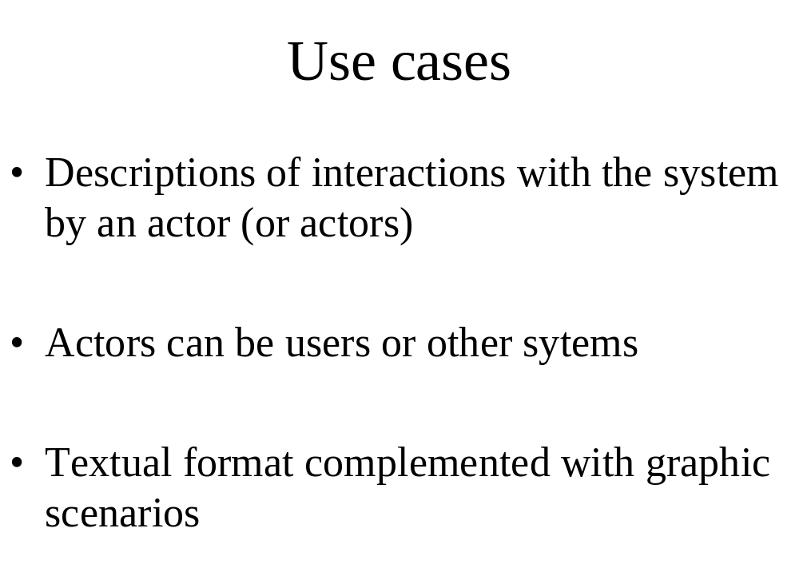

Slide 42
How to describe a single use case
A. Name: Give a short, descriptive name to the use case.
B. Actors: List the actors who can perform this use case.
C. Goals: Explain what the actor or actors are trying to achieve.
D. Preconditions: State of the system before the use case.
E. Summary: Give a short informal description.
F. Related use cases.
G. Steps: Describe each step using a 2-column format.
H. Postconditions: State of the system in following completion.
A and G are the most important

Slide 43
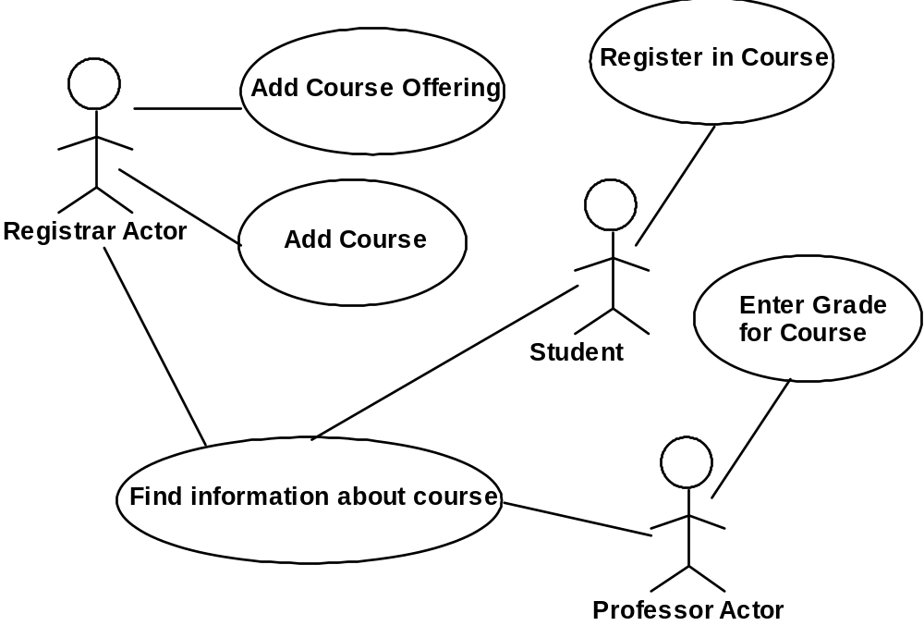
Use case diagrams

Slide 44
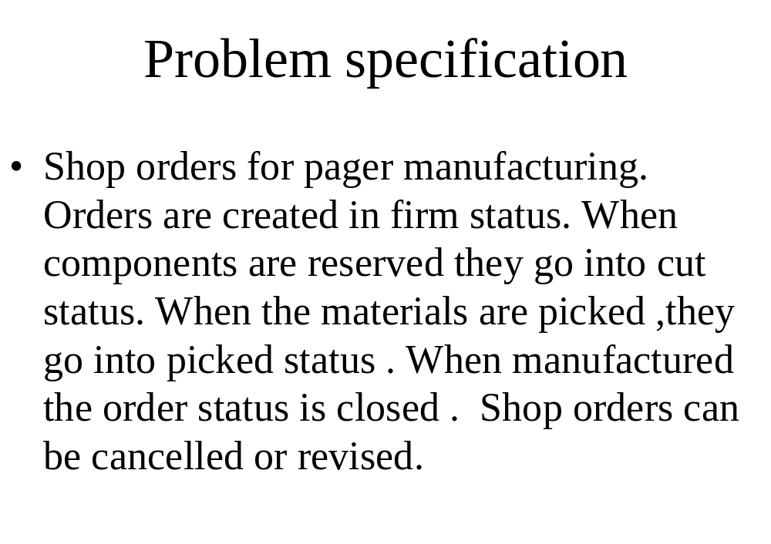

Slide 45
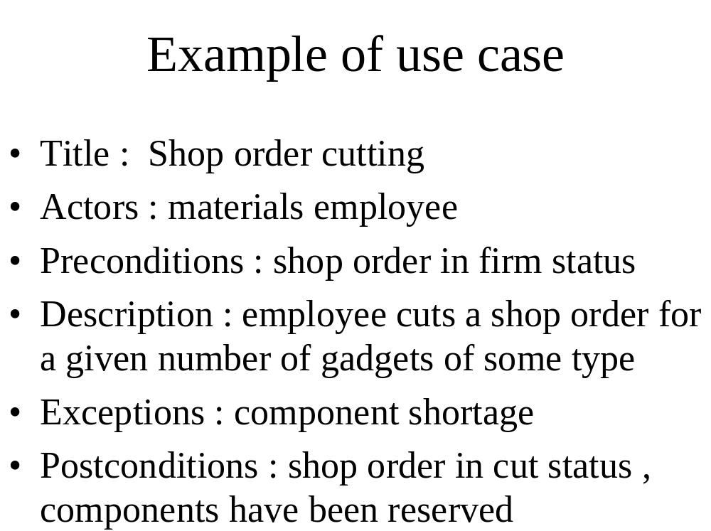

Slide 46
Use case diagram
Telephone Catalog
check
status
Salesperson
place
order
Shipping Clerk
Customer
fill
orders
establish
credit
Supervisor

Slide 47
Sequence diagrams
A type of Object Interaction diagram
Description of scenarios or event trace
Several sequence diagrams describe a use case
One sequence diagram for normal scenario and several for exceptional conditions

Slide 48
Sequence diagram
caller
exchange
receiver
a
lift receiver
{b-a < 1 sec.}
b
dial tone
{c - b < 10 sec.}
dial digit
c
...
The call is
routed through
the network
d
route
d’
phone rings
{d’ - d < 5 sec.}
ringing tone
answer phone
At this point
the parties
can talk
stop tone
stop ringing

Slide 49
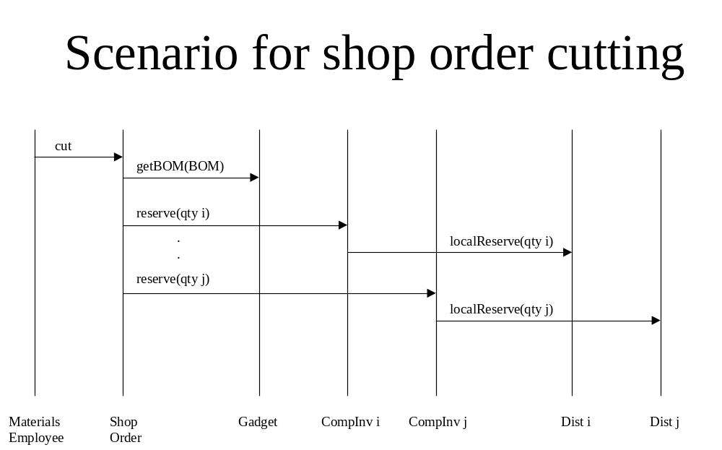

Slide 50
Sequence diagram with control
ob3:C3
ob4:C4
op()
ob1:C1
[x>0] foo(x)
ob2:C2
[x<0] bar(x)
doit(z)
doit(w)
more()

Slide 51
Collaboration diagram
:Order Entry Window
1: prepare()
Sequence Number
:Order
1.1.2.1:needToReorder
1.1*: prepare()
1.1.1 check()
1.1.2 [check==true] remove()
Macallan:Order Line
Macallan stock:Stock Item
1.1.3: [check == true] new
1.1.2.2: new
:Delivery Item
:Reorder Item

Slide 52
State
Typing Password
entry / set echo invisible
exit / set echo normal
character / handle character
help / display help

Slide 53
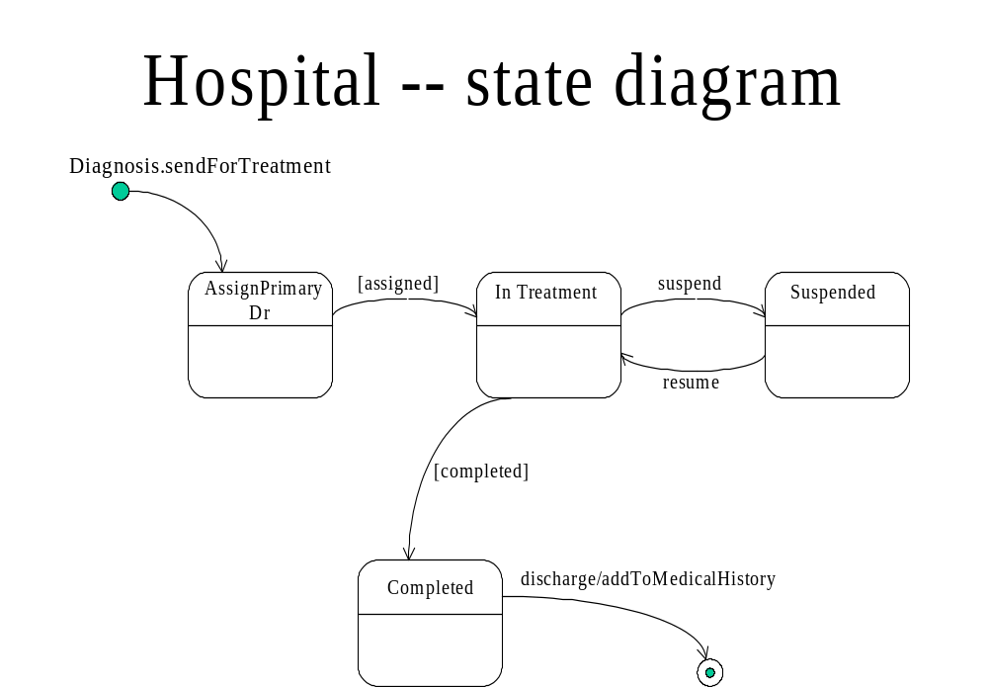

Slide 54
Activity diagram
Receive
Order
Multiple Trigger
for each line item on order
*
Cancel
Order
Authorize
Payment
Check
Line Item
[failed]
[succeeded]
[in stock]
Assign to
Order
Synchronization Condition
[need to
reorder]
[stock assigned to
all line items and
payment authorized]
Reorder
Item
Dispatch
Order

Slide 55
Deployment diagram
AdminServer:HostMachine
<database>>
:meetingsDB
:Scheduler
reservations
Joe’sMachine:PC
:Planner

Slide 56
Components
spell-check
Dictionary
synonyms
mymailer:Mailer
RoutingList
Mailbox

Slide 57
Summary
UML is a good notation and becoming the accepted standard
Not useful without knowledge of OO concepts
Use of patterns is important for model understanding and reusability
A good tool is important

Slide 58
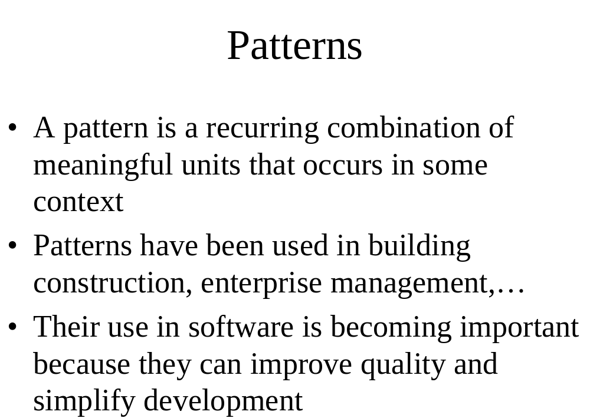

Slide 59
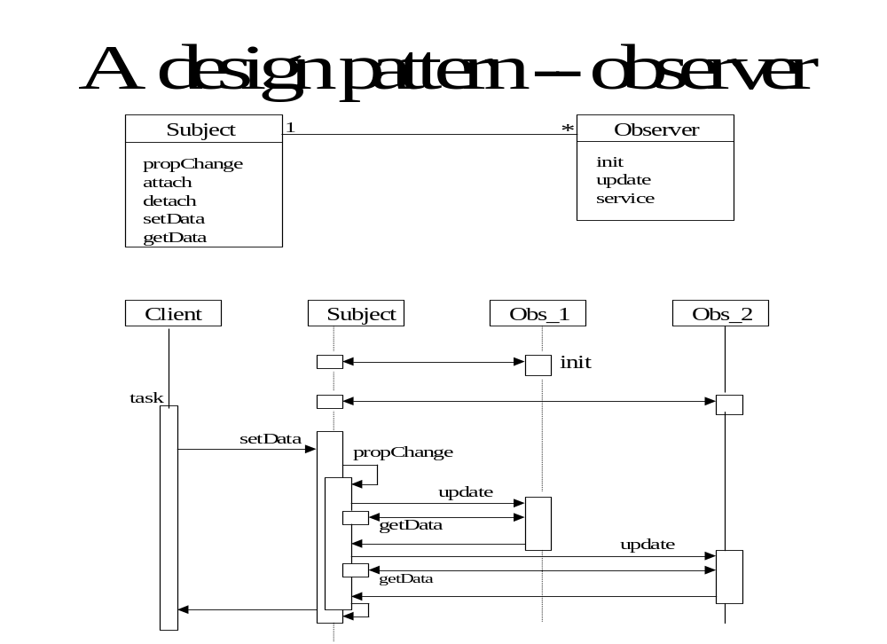

Slide 60
An architectural pattern: Broker
The Broker structures distributed systems with separate components that interact by remote service calls. A broker coordinates communications, including forwarding requests and sending back results and exceptions.
Forces
Components should be able to access remote services in a location-transparent way.
Components may need to be exchanged, added, or removed at execution time.
Implementation details should be hidden from the users of components and services.

Slide 61
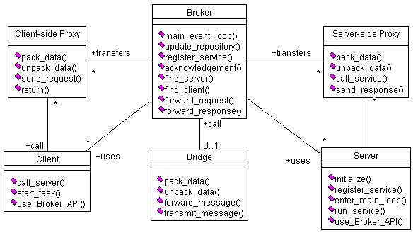
Class diagram of Broker

Slide 62
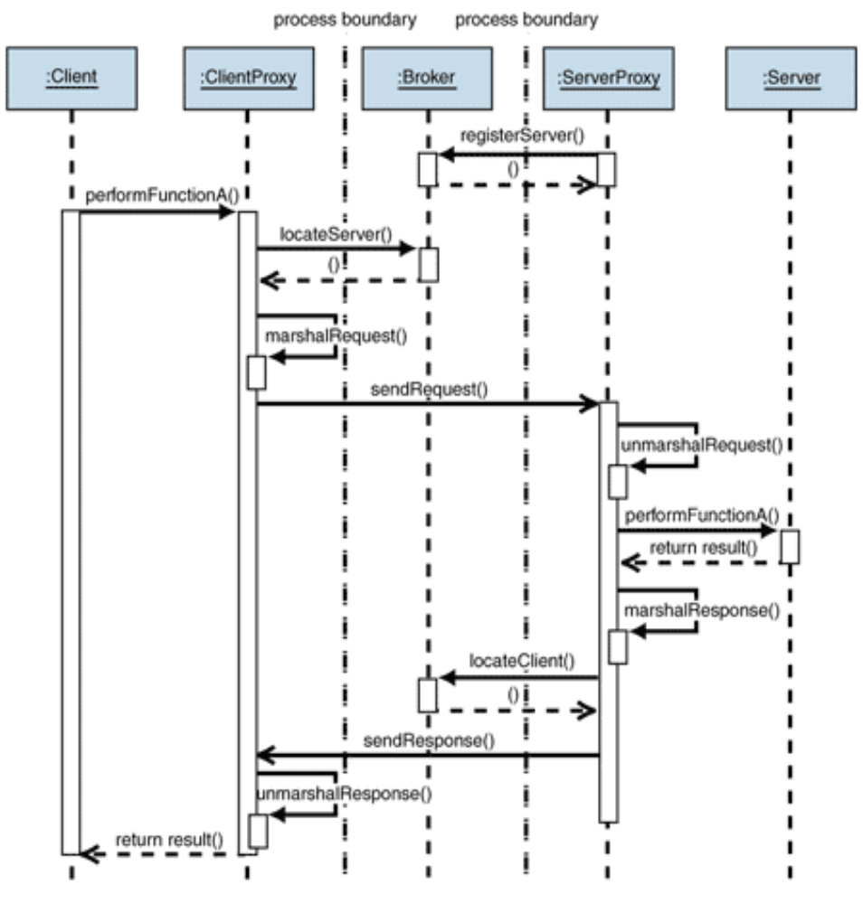
UCs: Register and Request Service

Slide 63
Known uses
CORBA
IBM’s SOM/DSOM
Microsoft’s DCOM, .NET Remoting
Sun’s RMI
This pattern (and the Layers and Lookup patterns) are used in the Bluetooth specification

Slide 64
Consequences
Advantagess
Remote objects or units can be accessed transparently, as if they were local
Changeability and extensibility of components
Interoperability between different Broker systems
Portability of a broker system because low level details are hidden from users
Reusability
Liabilities
Error handling
Lower fault tolerance
Restricted efficiency
Testing and debugging

Slide 65
Consequences
Advantagess
Remote objects or units can be accessed transparently, as if they were local
Changeability and extensibility of components
Interoperability between different Broker systems
Portability of a broker system because low level details are hidden from users
Reusability
Liabilities
Error handling
Lower fault tolerance
Restricted efficiency
Testing and debugging

Slide 66
Process approach
Incremental -- Implement a few use cases at a time
Iterative -- Parts of analysis, design, or implementation may be repeated

Slide 67
References
OMG (Object Management Group): http:http://www.uml.org/
//www.omg.org/uml
Patterns: http://www.hillside.net/patterns
OMG UML standard: http://www.uml.org/
Rational (IBM subsidiary): http://www-
306.ibm.com/software/rational/
General: http://www.objenv.com/cetus/software.html (about 20,000 links about all aspects of OO)-- Unly until 1996 but still useful
http://www.cs.virginia.edu/~mjl4x/oo.html

